Slide 1



World GDP to Happy Score
View in Power BI
Last data refresh:
30/12/2021 03:49:51 UTC
Downloaded at:
30/12/2021 04:11:15 UTC

Slide 2
Dataset Used
Title: Income and Happiness Correction
By Levy Edgar44
Income and Happiness Correction | Kaggle
This dataset reflects the relationship between income and happiness of 111 countries

Slide 3
Dataset Content
Country: country data
Adjusted, average, and standard (deviation) satisfaction: value of satisfaction in each country
Average and median income: value of income of each country
Region: division of countries by region in the world
Happy Score: the world happiness publication report by UN
GDP Score: monetary measure of the market value of all the final goods and services produced in a specific time period.

Slide 4
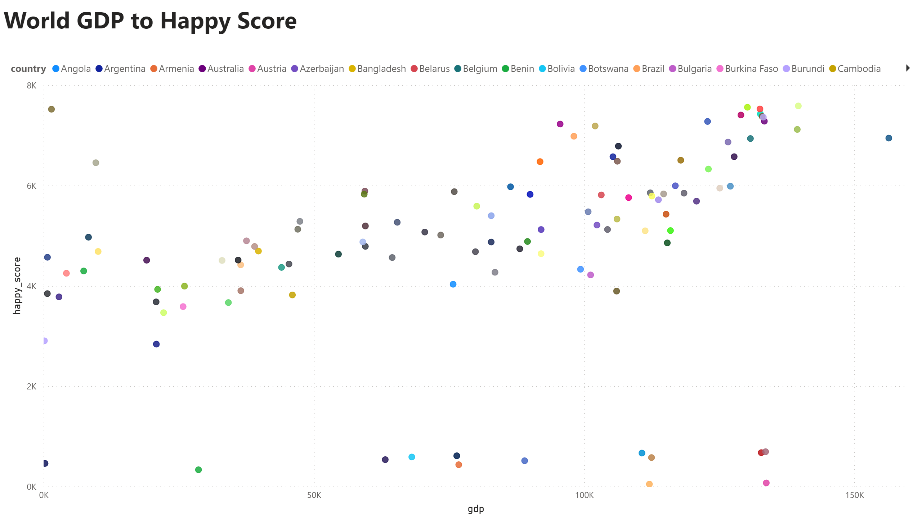
Sebaran
Notes:
scatterChart
No alt text provided
textbox
No alt text provided

Slide 5
Insights
There is only one country that is actually on the far right as the happiest country with the highest GDP
Some countries are at a low level of happiness, even though they have above-average GDP

Slide 6
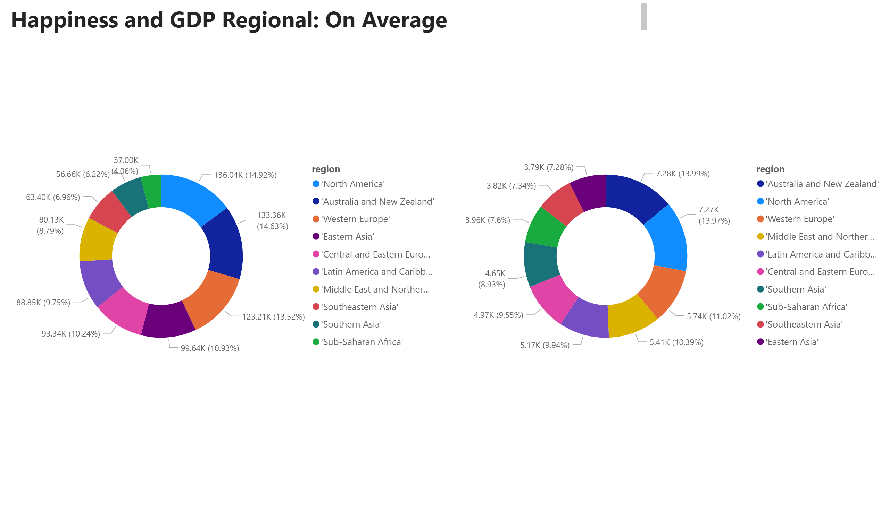
Rata-rata
Notes:
textbox
No alt text provided
donutChart
No alt text provided
donutChart
No alt text provided

Slide 7
Insights
Some parts of the country in Africa still have higher happiness rates, when compared directly to the value of their GDP.
Countries in Europe have GDP and happiness levels that are directly proportional.

Slide 8
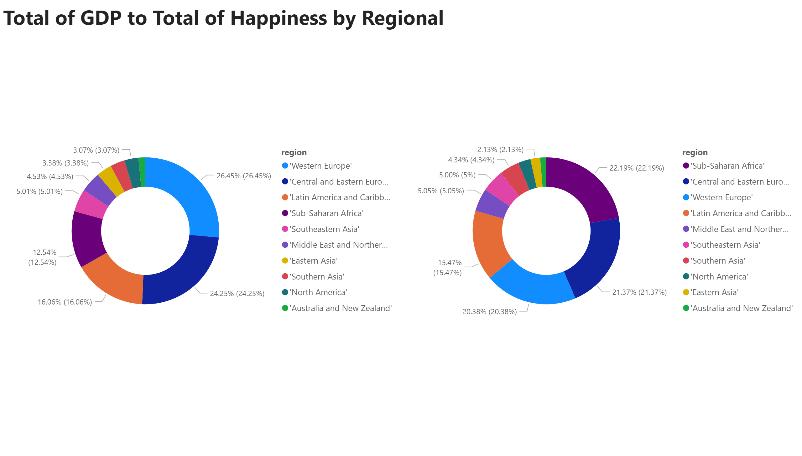
Total
Notes:
textbox
No alt text provided
donutChart
No alt text provided
donutChart
No alt text provided

Slide 9
Insights
In total, countries in Sub-Saharan and South Asia have a proportionally higher value of total happiness compared to the total GDP of the countries in those parts.

Slide 10
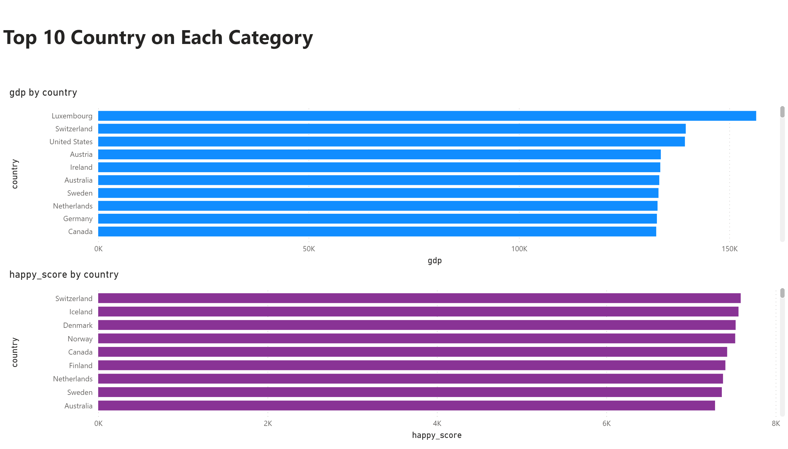
Top 10
Notes:
textbox
No alt text provided
clusteredBarChart
No alt text provided
clusteredBarChart
No alt text provided

Slide 11
Insights
Although there are also countries in the top 10 in the happy country category, not all countries in the top 10 GDP are in the top 10 happy countries.

